Slide 1
Create a basic interactive dashboard that shows sales performance by product, region, and month
Power BI

Slide 2
The West region stands out as the top performer in terms of overall sales.
The South region recorded the lowest sales volume among the four regions.
Sales in the East and Central regions are relatively similar, falling between the top and bottom performers.
Sales by Product Category:
Technology products contribute the largest share of the total sales revenue.
Office Supplies also represent a significant portion of the sales.
Furniture has the smallest contribution to the overall sales figures.
Top Performing Customers (Based on Sales):
Sean Miller is the customer with the highest total sales value.

Slide 3
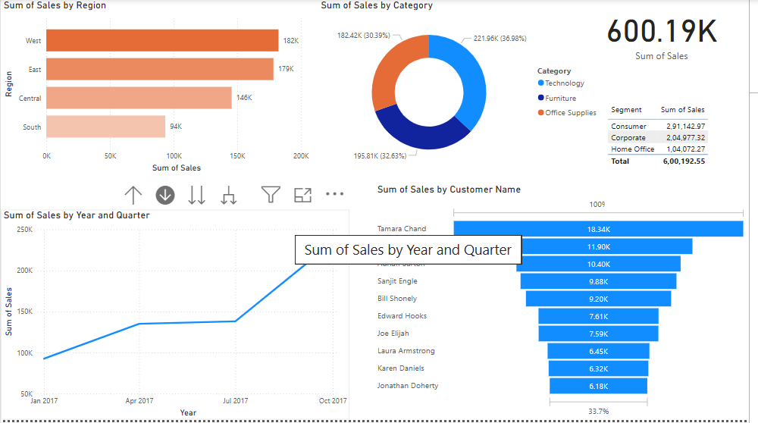
Sales Dashboard Design

Slide 4
THANK YOU

